Slide 1
Software Engineering
Prepared by: Neha Tripathi

Slide 2
Need of Software Engineering
The necessity of software engineering appears because of a higher rate of progress in user requirements and the environment on which the program is working.
Huge Programming: It is simpler to manufacture a wall than to a house or building, similarly, as the measure of programming become extensive engineering has to step to give it a scientific process.
Adaptability: If the software procedure were not based on scientific and engineering ideas, it would be simpler to re-create new software than to scale an existing one.
Cost: As the hardware industry has demonstrated its skills and huge manufacturing has let down the cost of computer and electronic hardware. But the cost of programming remains high if the proper process is not adapted.
Dynamic Nature: The continually growing and adapting nature of programming hugely depends upon the environment in which the client works. If the quality of the software is continually changing, new upgrades need to be done in the existing one.
Quality Management: Better procedure of software development provides a better and quality software product.

Slide 3
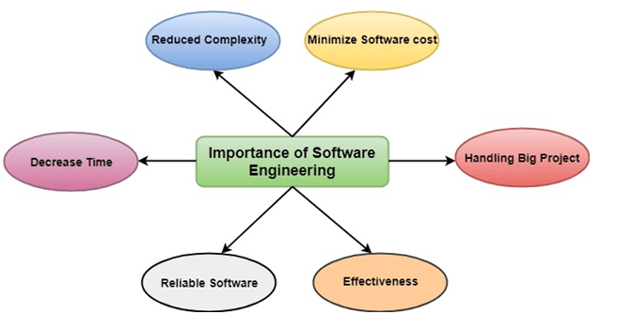
Importance of Software Engineering

Slide 4
Importance of Software Engineering
Reduces complexity:
Big software is always complicated and challenging to progress. Software engineering has a great solution to reduce the complication of any project. Software engineering divides big problems into various small issues. And then start solving each small issue one by one. All these small problems are solved independently to each other.
To minimize software cost:
Software needs a lot of hardwork and software engineers are highly paid experts. A lot of manpower is required to develop software with a large number of codes. But in software engineering, programmers project everything and decrease all those things that are not needed. In turn, the cost for software productions becomes less as compared to any software that does not use software engineering method.
To decrease time:
Anything that is not made according to the project always wastes time. And if you are making great software, then you may need to run many codes to get the definitive running code. This is a very time-consuming procedure, and if it is not well handled, then this can take a lot of time. So if you are making your software according to the software engineering method, then it will decrease a lot of time.

Slide 5
Handling big projects:
Big projects are not done in a couple of days, and they need lots of patience, planning, and management. And to invest six and seven months of any company, it requires heaps of planning, direction, testing, and maintenance. No one can say that he has given four months of a company to the task, and the project is still in its first stage. Because the company has provided many resources to the plan and it should be completed. So to handle a big project without any problem, the company has to go for a software engineering method.
Reliable software:
Software should be secure, means if you have delivered the software, then it should work for at least its given time or subscription. And if any bugs come in the software, the company is responsible for solving all these bugs. Because in software engineering, testing and maintenance are given, so there is no worry of its reliability.
Effectiveness:
Effectiveness comes if anything has made according to the standards. Software standards are the big target of companies to make it more effective. So Software becomes more effective in the act with the help of software engineering.

Slide 6
Applications of Software
The most significant factor in determining which software engineering methods and techniques are most important is the type of application that is being developed.
System Software: A collection of programs written to service other programs. Compiler, device driver, editors, file management.
Application software or stand alone program: It solves a specific Business needs. It is needed to convert the business function in real time. Example -point of sale, Transaction processing, real time manufacturing control.
Scientific / Engineering Software: Applications like based on astronomy, automative stress analysis , molecular Biology, volcanology, space Shuttle orbital dynamic, automated manufacturing.
Embedded Software: There are software control systems that control and manage hardware devices. Example- software in mobile phone, software in Anti Lock Braking in car, software in microwave oven to control the cooking process.

Slide 7
Product Line Software: It is designed to provide a specific capability for use by many different customers. It can focus on unlimited or esoteric Marketplace like inventory control products. Or address mass market place like : Spreadsheets, computer graphics, multimedia, entertainment, database management, personal, business financial applications.
Web application: It is also called " web apps ", are evolving into sophisticated computing environment that not only provide stand alone features, computing functions, and content to the end user but also are integrated with corporate database and business applications.
Artificial intelligence software: This include- robotic, expert system, pattern recognition, image and voice, artificial neural network, game playing, theorem proving ... It solves Complex problems.

Slide 8
Networking and Web Applications Software –Networking Software provides the required support necessary for computers to interact with each other and with data storage facilities. The networking software is also used when software is running on a network of computers (such as World Wide Web). It includes all network management software, server software, security and encryption software and software to develop web-based applications like HTML, PHP, XML, etc.
Business Software –This category of software is used to support the business applications and is the most widely used category of software. Examples are software for inventory management, accounts, banking, hospitals, schools, stock markets, etc.
Entertainment Software –Education and entertainment software provides a powerful tool for educational agencies, especially those that deal with educating young children. There is a wide range of entertainment software such as computer games, educational games, translation software, mapping software, etc.

Slide 9
Utilities Software –The programs coming under this category perform specific tasks and are different from other software in terms of size, cost and complexity. Examples are anti-virus software, voice recognition software, compression programs, etc.
Document Management Software –A Document Management Software is used to track, manage and store documents in order to reduce the paperwork. Such systems are capable of keeping a record of the various versions created and modified by different users (history tracking). They commonly provide storage, versioning, metadata, security, as well as indexing and retrieval capabilities.
Reservation Software –A Reservation system is primarily used to store and retrieve information and perform transactions related to air travel, car rental, hotels, or other activities. They also provide access to bus and railway reservations, although these are not always integrated with the main system. These are also used to relay computerized information for users in the hotel industry, making a reservation and ensuring that the hotel is not overbooked.

Slide 10
Thank you!

